Slide 1
Natural Language Processing
Introduction
Chap. 1

Slide 2
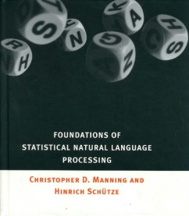

References
Foundations of Statistical Natural Language Processing, by Chris Manning and Hinrich Schutze, MIT Press, 1999.
Speech and Language Processing, Daniel Jurafsky & James H. Martin. Prentice Hall, 2000.
https://nlp.stanford.edu/links/statnlp.html

Slide 3
Other References
Proceedings of major conferences
ACL: Association for Computational Linguistics
EACL: European chapter of ACL
ANLP: Applied NLP
COLING: Computational Linguistics
TREC: Text Retrieval Conference

Slide 4
Why study NLP?
necessary to many useful applications:
information retrieval,
information extraction,
filtering,
spelling and grammar checking,
automatic text summarization,
machine translation…

Slide 5
Who needs NLP?
Too many texts to manipulate
On Internet
E-mails
Various corporate documentation
Too many languages
39000 languages and dialects

Slide 6
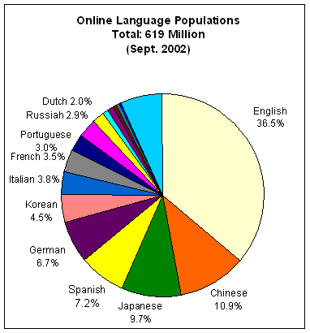
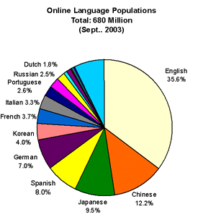
Languages on the Internet
Source: Global Reach (www.glreach.com)
Notes:
In fact, native English speakers are already a minority on the web.
Chinese speakers are projected to pass us on the web in 2007 – Chinese being the biggest language in the world.
And at the other end of the spectrum, there are hundreds of little bitty languages. They don’t show up on this chart, but they sure come in handy when you’re a U.N. peacekeeper or a tourist or a penpal or a businessperson or a websurfer.

Slide 7
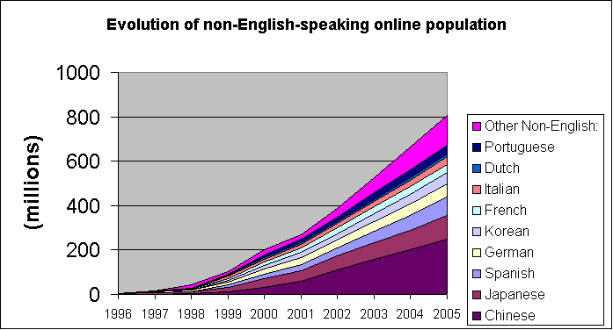
Source: Global Reach (www.glreach.com)
Notes:
[globalization …]
And they’re not all doing it in English! Contrary to popular belief.

Slide 8
Applications of NLP
Text-based: processing of written texts (ex. Newspaper articles, e-mails, Web pages…)
Text understanding/analysis (NLU)
IR, IE, MT, …
Text generation (NLG)
CLIME (Computerized Legal Information Management and Explanation)
Dialog-based systems (human-machine communication)
Ex: QA, tutoring systems, …

Slide 9
Brief history of NLP
1940s - 1950s Foundational Insights
Automata, finite-state machines & formal languages (Turing, Chomsky, Backus&Naur)
Probability and information theory (Shannon)
Noisy channel and decoding (Shannon)
1960s - 1970s
Symbolic: Linguists & Computer Scientists
Transformational grammars (Chomsky, Harris)
Artificial Intelligence (Minsky, McCarthy)
Theorem Proving, heuristics, general problem solver (Newell&Simon)
Stochastic: Statisticians & Electrical Engineers
Bayesian reasoning for character recognition
Authorship attribution
Corpus Work

Slide 10
Brief history of NLP (con’t)
1970s - 1980s
Stochastic approaches
Logic-based / Rule-based approaches
Scripts and plans for NL understanding of “toy worlds”
Discourse modeling (discourse structures & coreference resolution)
Late 1980s - 1990s Rise of probabilistic models
Data-driven probabilistic approaches (more robust)
Engineering practical solutions using automatic learning
Strict evaluation of work

Slide 11
Why study NLP Statistically?
Up to about 10 years, NLP was mainly investigated using a rule-based approach.
But:
Rules are often too strict to characterize people’s use of language (people tend to stretch and bend rules in order to meet their communicative needs.)
Need (expert) people to develop rules (knowledge acquisition bottleneck)
Statistical methods are more flexible & more robust

Slide 12
Tools and Resources Needed
Probability/Statistical Theory:
Statistical Distributions, Bayesian Decision Theory.
Linguistics Knowledge:
Morphology, Syntax, Semantics, Pragmatics…
Corpora:
Bodies of marked or unmarked text
to which statistical methods and current linguistic knowledge can be applied
in order to discover novel linguistic theories or interesting and useful knowledge to build applications.

Slide 13
The Alphabet Soup
NLP → Natural Language Processing
CL → Computational Linguistics
NLE → Natural Language Engineering
HLT → Human Language Technology
IE → Information Extraction
IR → Information Retrieval
MT → Machine Translation
QA → Question-Answering
POS → Part-of-speech
NLG → Natural Language Generation
NLU → Natural Language Understanding

Slide 14
Why is NLP difficult?
Because Natural Language is highly ambiguous.
Syntactic ambiguity
I made her duck.
has 2 parses (i.e., syntactic analysis)
The president spoke to the nation about the problem of drug use in the schools from one coast to the other.
has 720 parses.
Ex:
“to the other” can attach to any of the previous NPs (ex. “the problem”), or the head verb → 6 places
“from one coast” has 5 places to attach
…
(S (NP I) (VP (V made) (NP (PRO her) (N duck))) | (S (NP I) (VP (V made) (NP (PRO her) (VP (V duck))))

Slide 15
Why is NLP difficult? (con’t)
Word category ambiguity
book --> verb? or noun?
Word sense ambiguity
bank --> financial institution? building? or river side?
Words can mean more than their sum of parts
make up a story
Defining scope
People like ice-cream.
Does this mean that all (or some?) people like ice cream?
Language is changing and evolving
I’ll email you my answer.
This new S.U.V. as a compartment for your mobile phone.

Slide 16
Methods that do not work well
Hand-coded rules
produce a knowledge acquisition bottleneck
perform poorly on naturally occurring text
I swallowed his story / line.

Slide 17
What Statistical NLP can do
seeks to solve the acquisition bottelneck:
by automatically learning preferences from corpora (ex, lexical or syntactic preferences).
offers a solution to the problem of ambiguity and "real" data because statistical models
are robust
generalize well
behave gracefully in the presence of errors and new data.

Slide 18
Some standard corpora
Brown corpus
~1 million words
Tagged corpus (POS)
Balanced (representative sample of American English in the 1960-1970) (different genres)
Lancaster-Oslo-Bergen (LOB) corpus
British replication of the Brown corpus
Susanne corpus
Free subset of Brown corpus (130 000 words)
Syntactic structure
Penn Treebank
Syntactic structure
Articles from Wall Street Journal
Canadian Hansard
Bilingual corpus of parallel texts

Slide 19
What to do with text corpora? Count words
Count words to find:
What are the most common words in the text?
How many words are in the text?
word tokens vs word types
What is the average frequency of each word in the text?

Slide 20
What’s a word anyways?
I have a can opener; but I can’t open these cans.
how many words?
Word form
inflected form as it appears in the text
can and cans ... different word forms
Lemma
a set of lexical forms having the same stem, same POS and same meaning
can and cans … same lemma
Word token:
an occurrence of a word
I have a can opener; but I can’t open these cans. 11 word tokens (not counting punctuation)
Word type:
a different realization of a word
I have a can opener; but I can’t open these cans. 10 word types (not counting punctuation)

Slide 21
An example
Mark Twain’s Tom Sawyer
71,370 word tokens
8,018 word types
tokens/type ratio = 8.9 (indication of text complexity)
Complete Shakespeare work
884,647 word tokens
29,066 word types
tokens/type ratio = 30.4

Slide 22
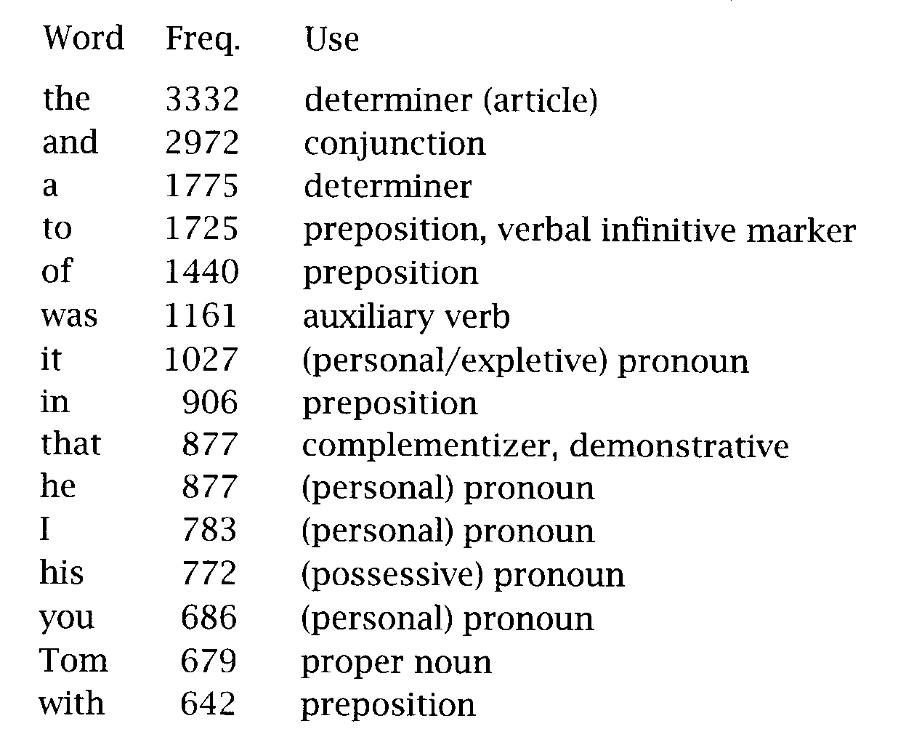
Common words in Tom Sawyer
but words in NL have an uneven distribution…

Slide 23
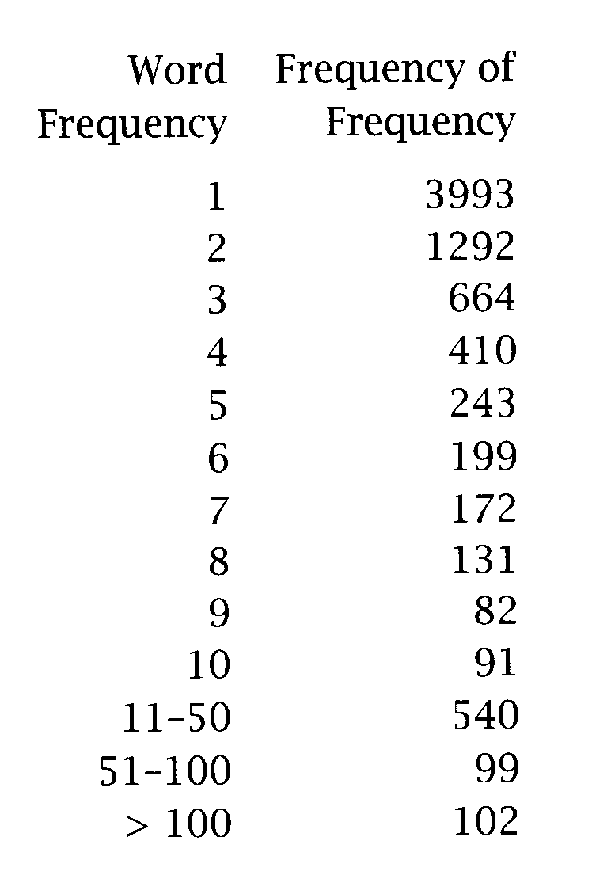
Frequency of frequencies
most words are rare
3993 (50%) word types appear only once
they are called hapax legomena (read only once)
but common words are very common
100 words account for 51% of all tokens (of all text)

Slide 24
Word counts are interesting...
As an indication of a text’s style
As an indication of a text’s author
But, because most words appear very infrequently,
it is hard to predict much about the behavior of words (if they do not occur often in a corpus)
--> Zipf’s Law

Slide 25
Zipf’s Law
Count the frequency of each word type in a large corpus
List the word types in order of their frequency
Let:
f = frequency of a word type
r = its rank in the list
Zipf’s Law says: f ∝ 1/r
In other words:
there exists a constant k such that: f × r = k
The 50th most common word should occur with 3 times the frequency of the 150th most common word.

Slide 26
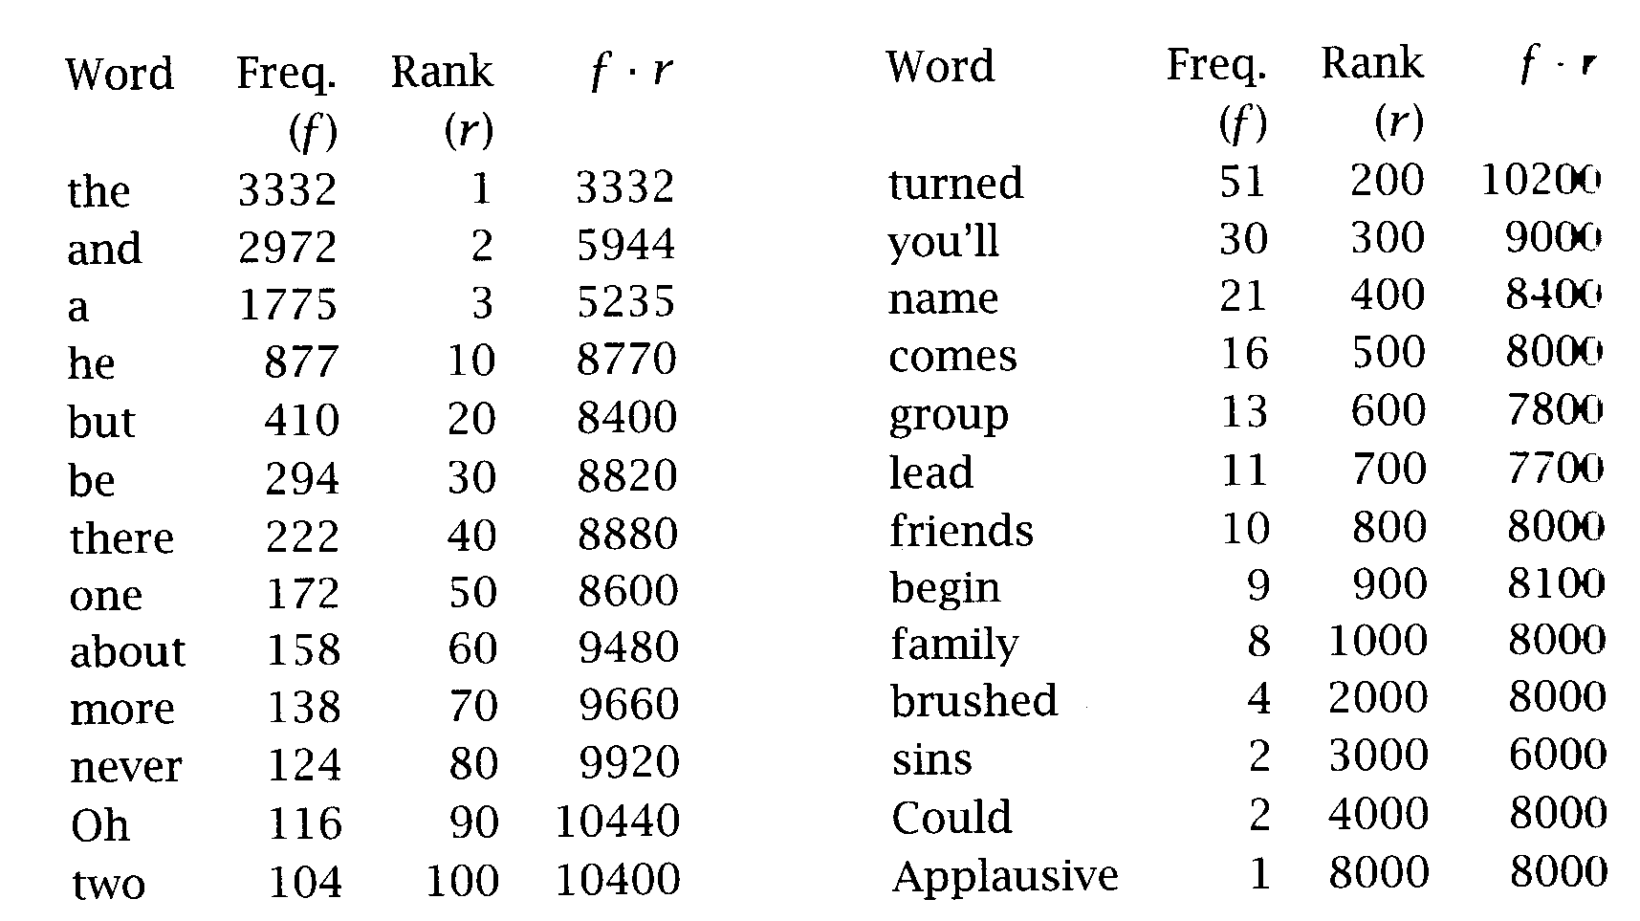
Zipf’s Law on Tom Saywer
k ≈ 8000-9000
except for
The 3 most frequent words
Words of frequency ≈ 100

Slide 27
What to do with text corpora? Find Collocations
Collocation: a phrase where the whole expression is perceived as having an existence beyond the sum of its parts
disk drive, make up, bacon and eggs…
important for machine translation
strong tea --> thé fort
strong argument -->?argument fort (convainquant)
can be extracted from a text
find the most common bigrams
however, since these bigrams are often insignificant (ex, “at the”, “of a”)
they can be filtered.

Slide 28
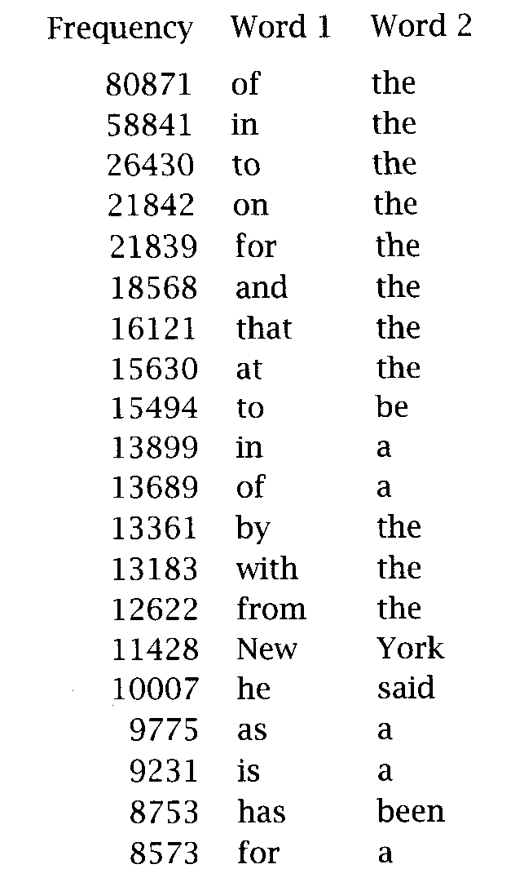
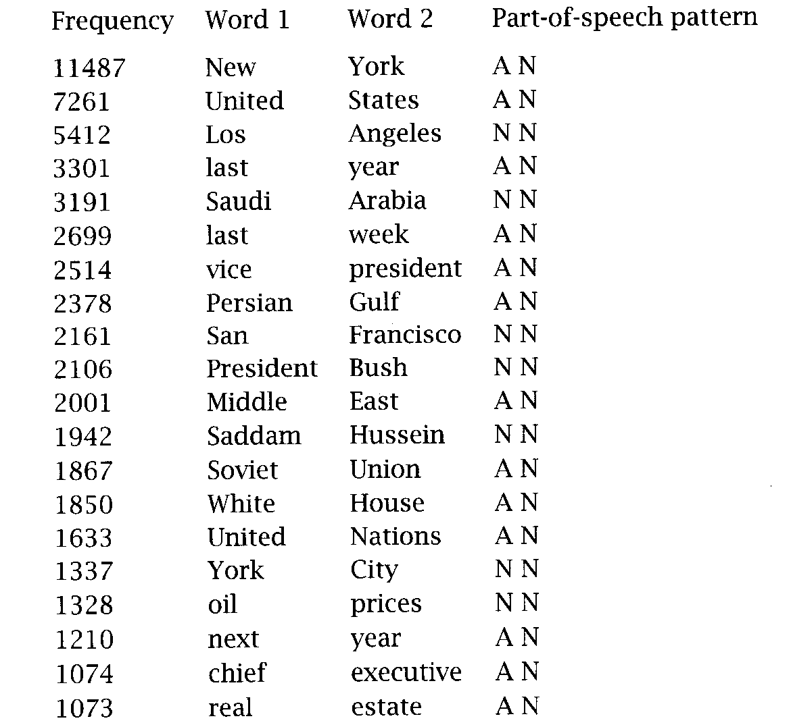
Collocations
Raw bigrams
Filtered bigrams

Slide 29
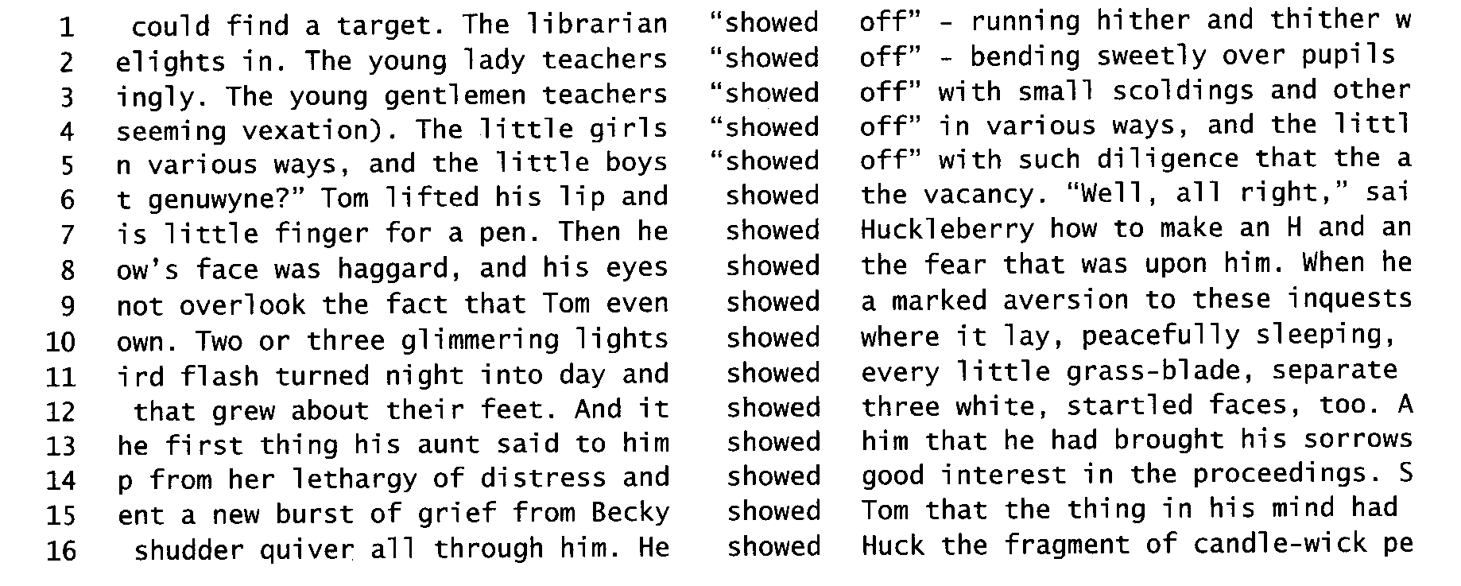
What to do with text corpora? Concordances
Find the different contexts in which a word occurs.
Key Word In Context (KWIC) concordancing program.

Slide 30
Concordances
useful for:
Finding syntactic frames of verbs
Transitive? Intransitive?
Building dictionaries for learners of foreign languages
Guiding statistical parsers

